Slide 1
Food - Aid

Slide 2

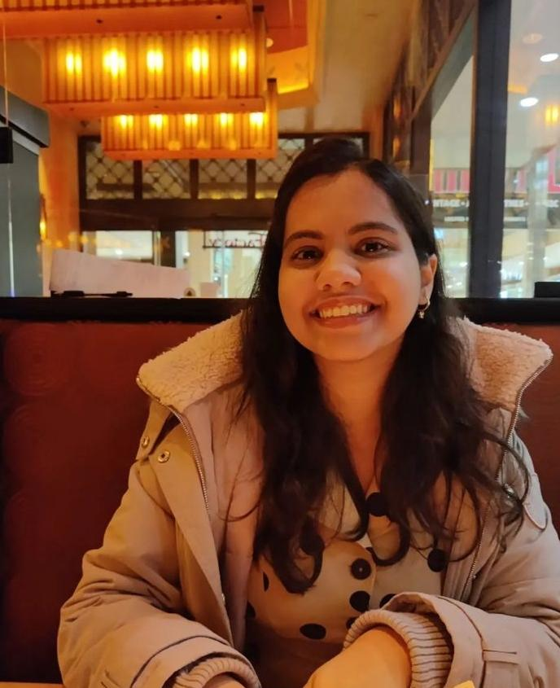

Team Members
Anubhuti Puppalwar CS Student @ RIT
WiC Member
Disha Revandkar CS Student @ RIT
WiC Member
Rajvi Sheth CS Student @ RIT
WiC Member

Slide 3
1.3 Billion Tons
This is the food wasted every day all over the world!

Slide 4
Food-Aid is a website which provides tools and resources to reduces the food that goes into the bin and makes an impact on food waste management chain.

Slide 5
Main Page
Insights
Chatbot
Food Management

Slide 6
About
Home page
Know more about food wasted and donation of food and chatbot.
Insights about the food wasted by disposal methods, top wasted food items, total weight of was by type and wastage reason.
Did exploratory data analysis on the food wastage dataset to show the analysis of important insights using python.
A page to look for food donating houses near you and in your city.
Donating house will donate good food and without cost.
Description of house address and type of food will be given.
Chatbot suggest recipes based on user input, and provide information on local food banks or donation centers.

Slide 7
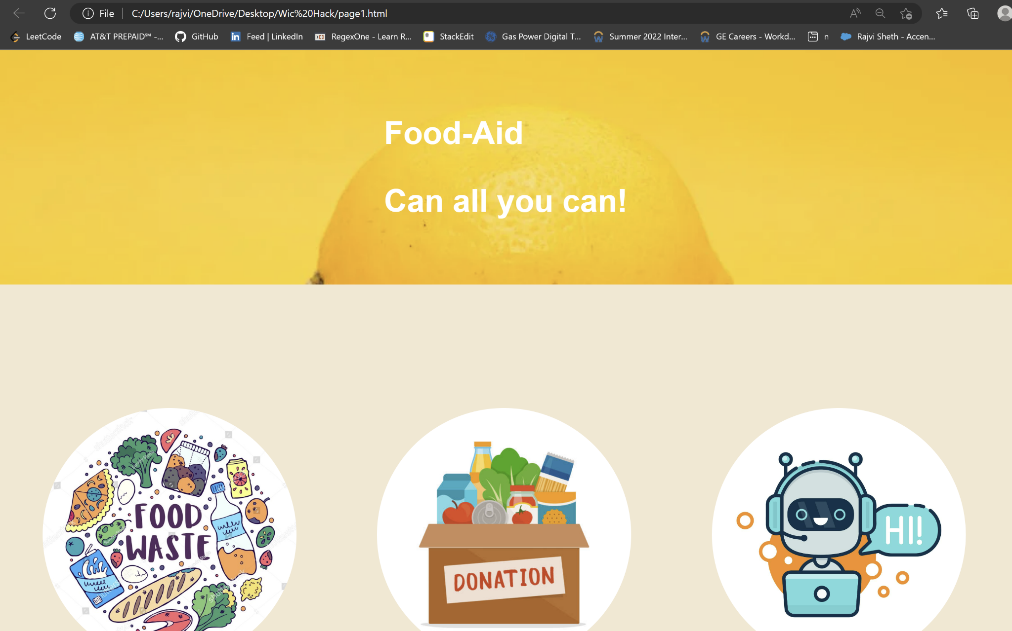
Our WEbsite

Slide 8
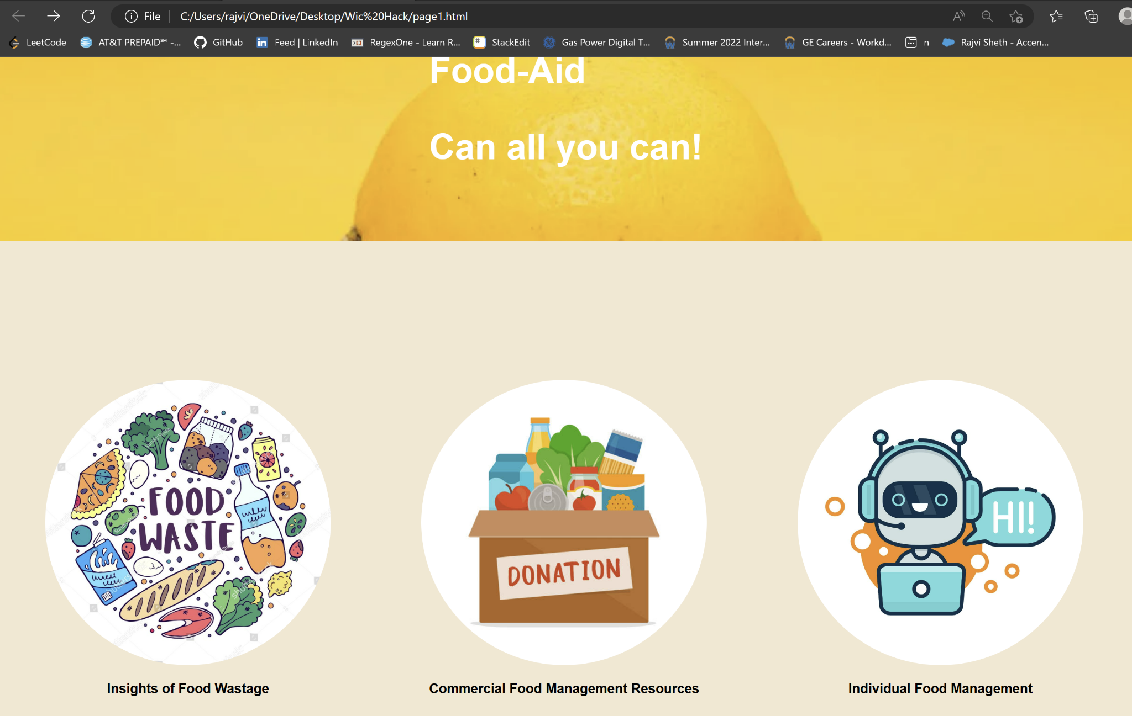

Slide 9
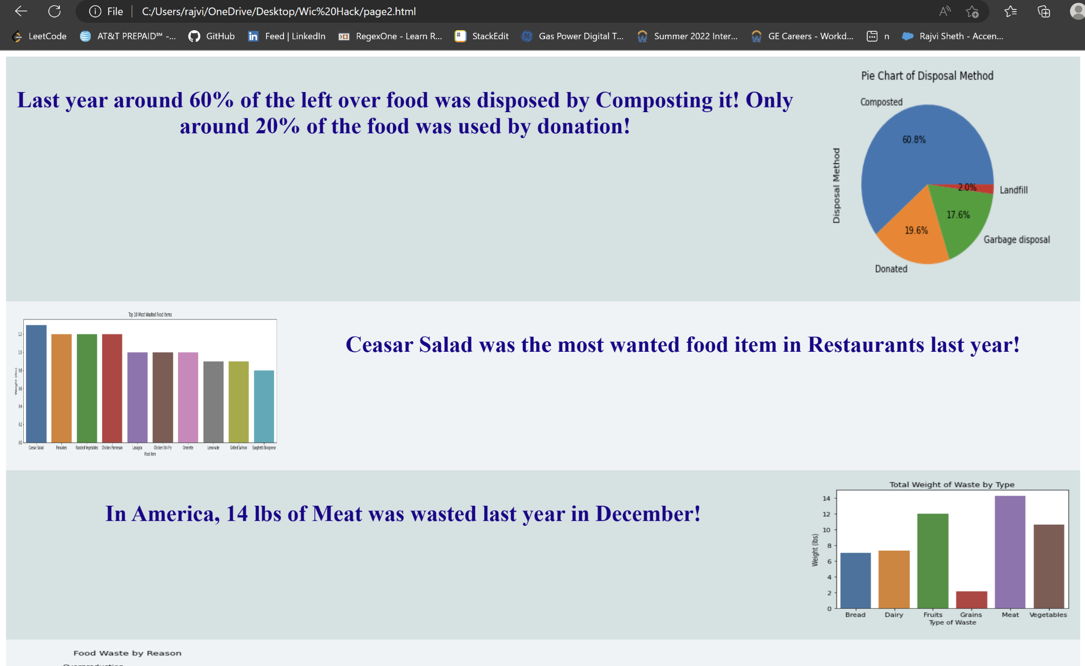

Slide 10
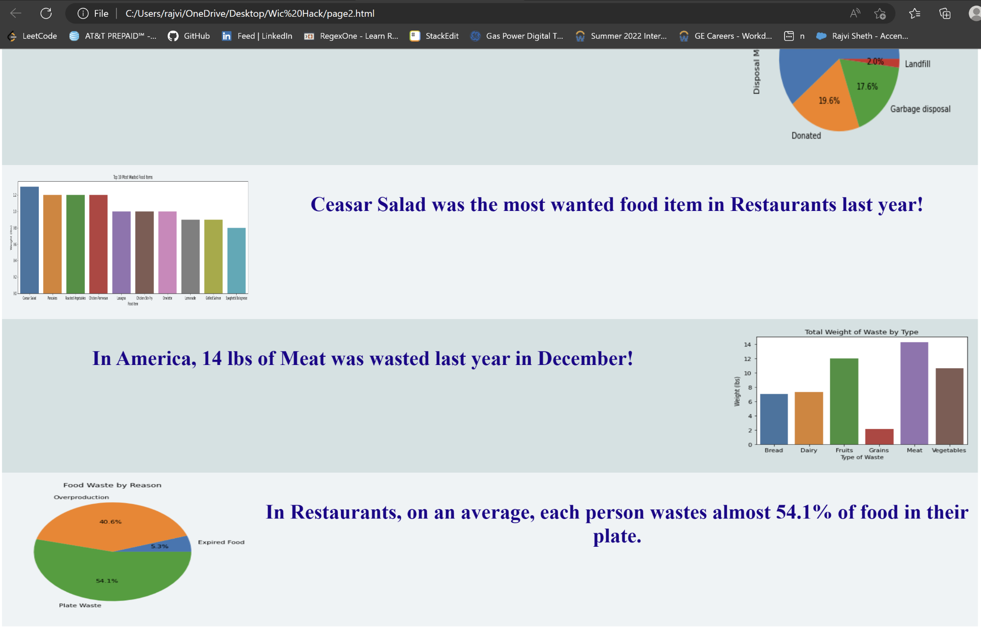

Slide 11
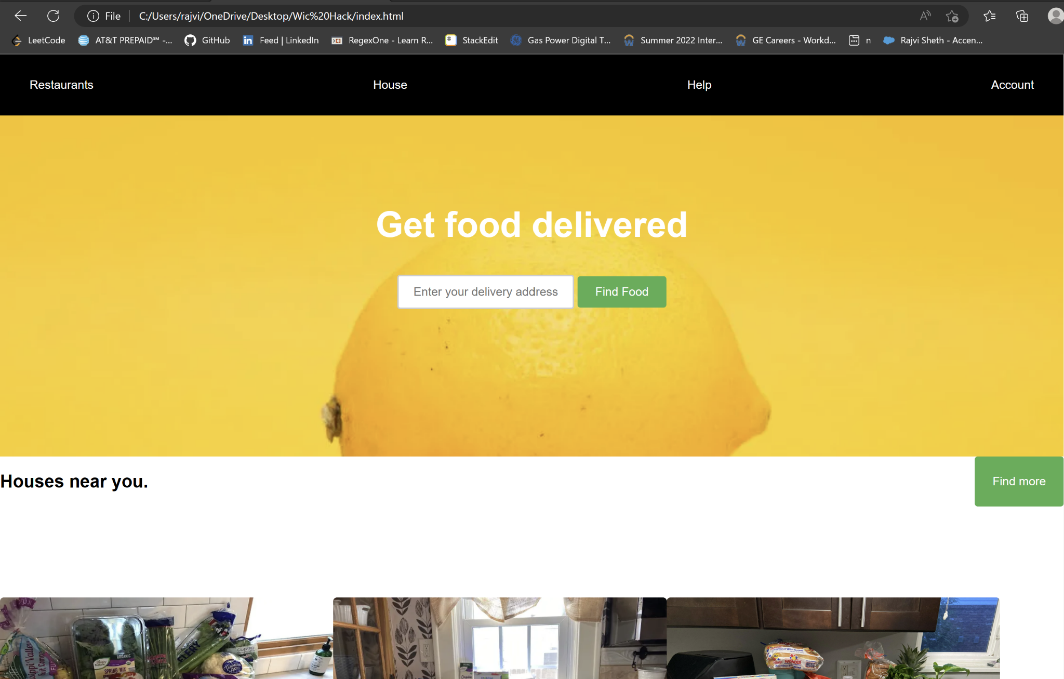

Slide 12
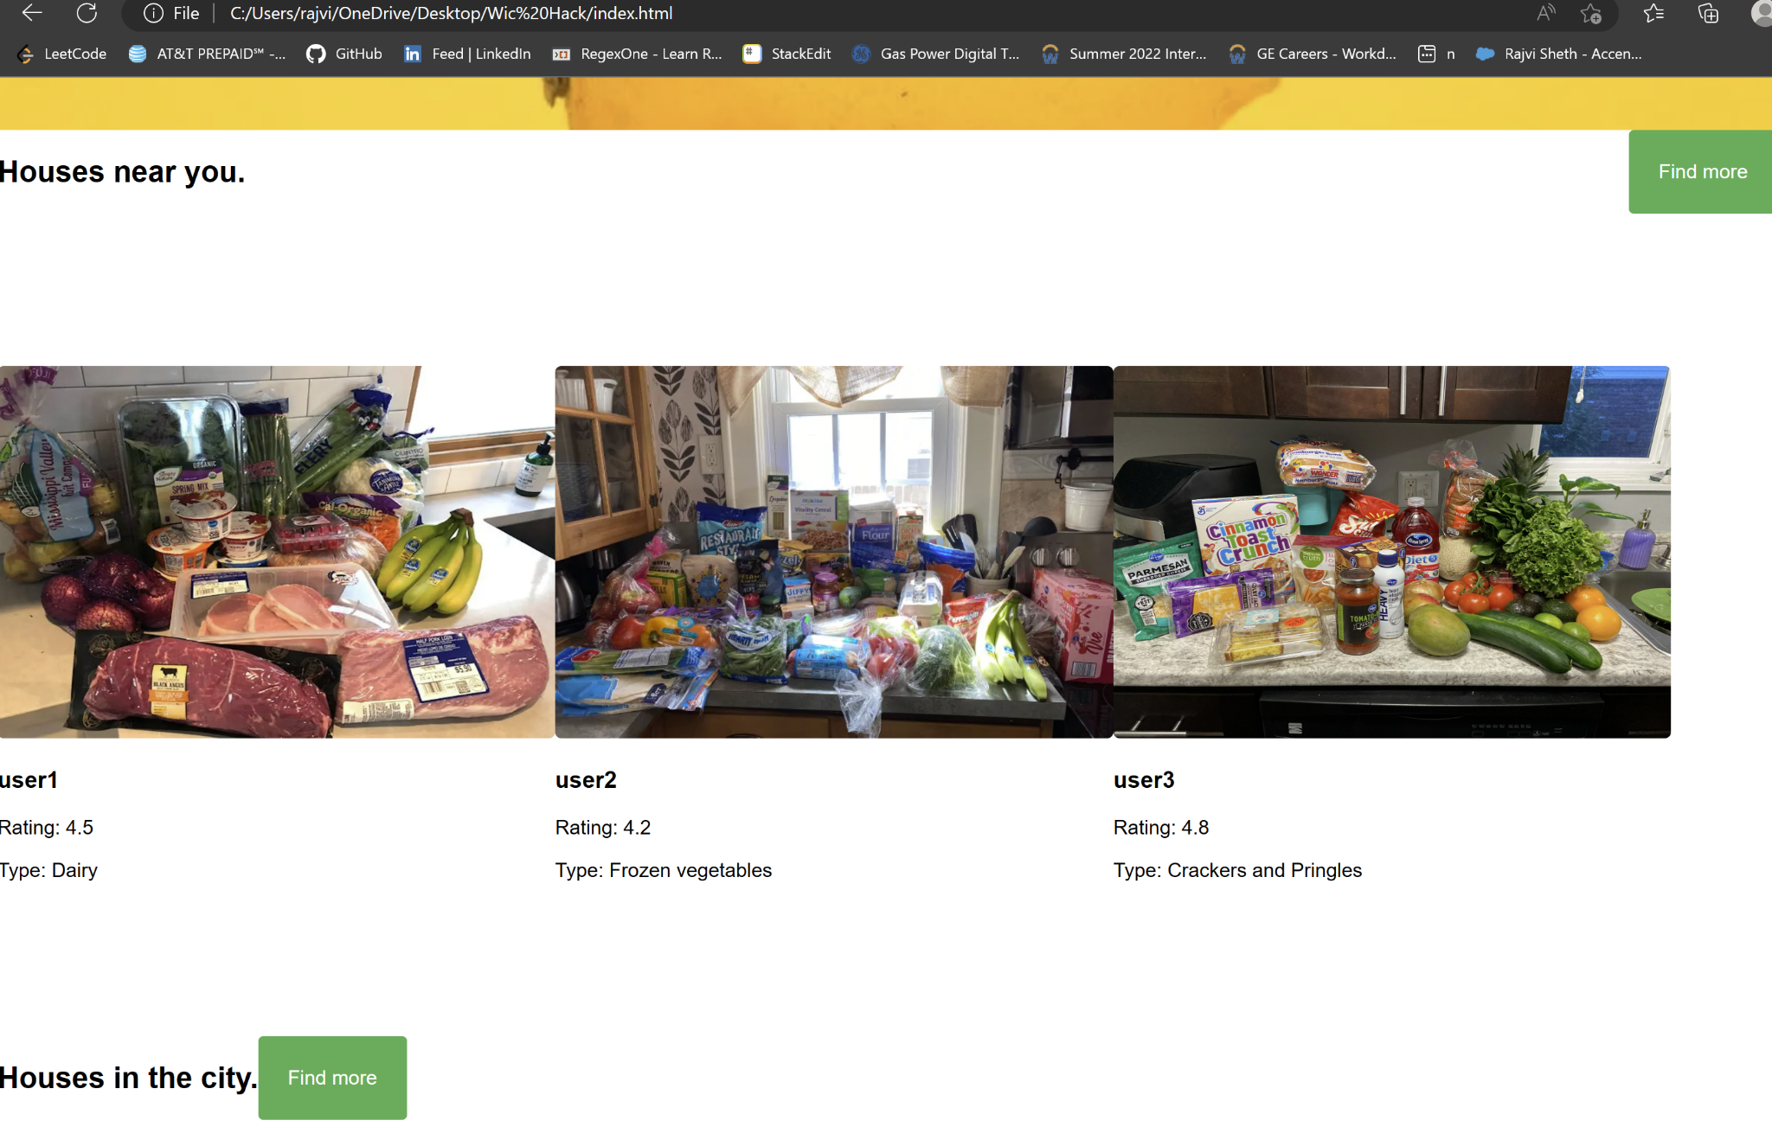

Slide 13
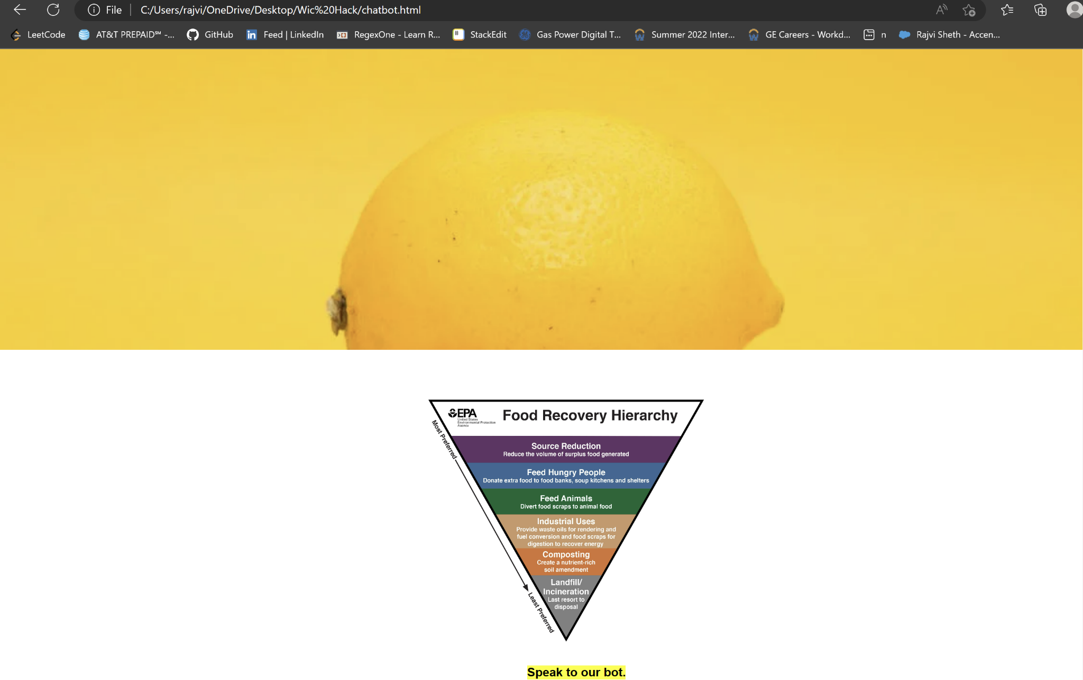

Slide 14
Tools And Languages Used to Create our Website
Jupyter Notebook
Visual Studio
Python
Numpy
Matplotlib
HTML
CSS
JavaScript
Python

Slide 15
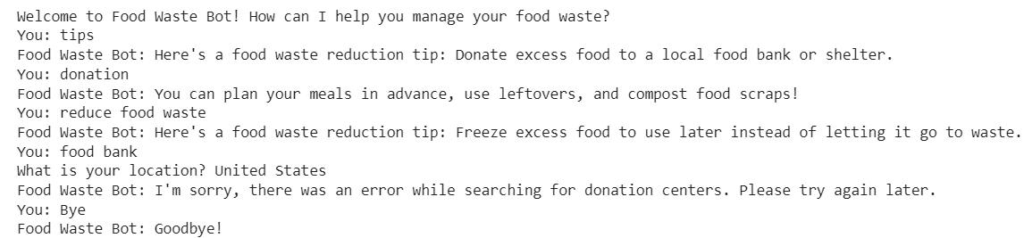
Our chatbot

Slide 16
Tools used to create chatbot
We created a user friendly chatbot for individuals to manage food donation and provide resources to reduce the food that goes in the bin.
It uses the ChatterBot library to train a chatbot on a list of sample conversations. The bot can provide tips on reducing food waste, suggest recipes based on user input, and provide information on local food banks or donation centers.

Slide 17
Future Scope
Backend can be integrated.
Show location points on map for open refrigerators.
Account creation and login pages.
Page for a person to donate food.
Data analysis on real time data and update real time graphs based on EDA.

Slide 18


